Slide 1
Active Sensing and Tracking
Aided by Learning
Department of Electrical and Electronics Engineering
The Hong Kong Polytechnic University

Slide 2
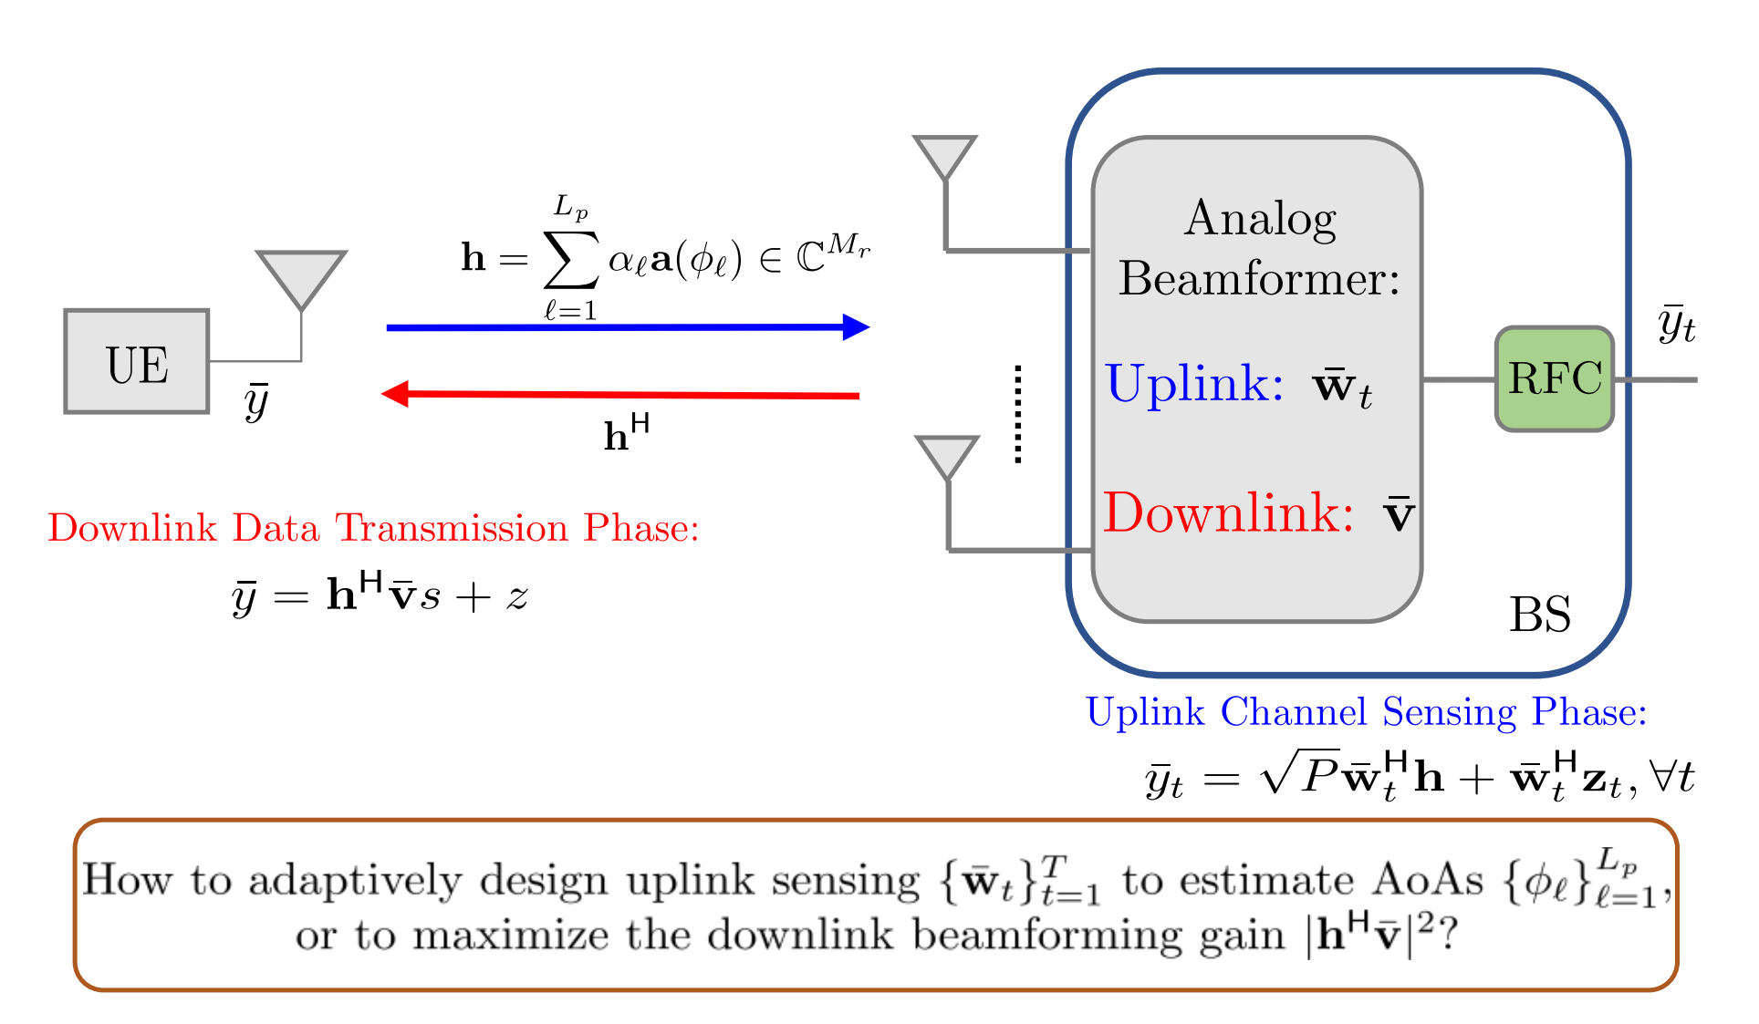
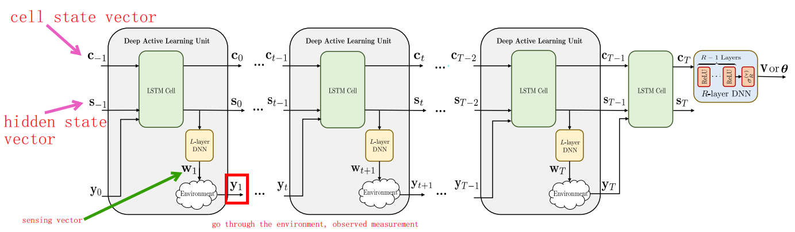
Active Sensing
The received pilot signal in uplink is
uplink
The beamforming vector in time t+1 can be estimated as
The AOA vector is obtained by all historical observations:
The AoA estimation problem for initial beam alignment in a
mmWave environment
F. Sohrabi, T. Jiang, et al. Active Sensing for Communications by Learning, IEEE JSAC, 2022

Slide 3
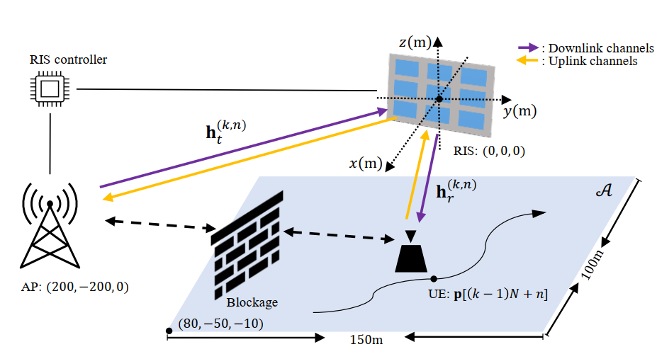
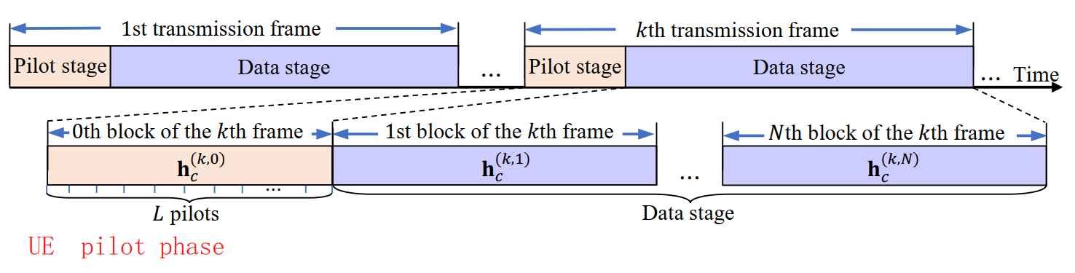
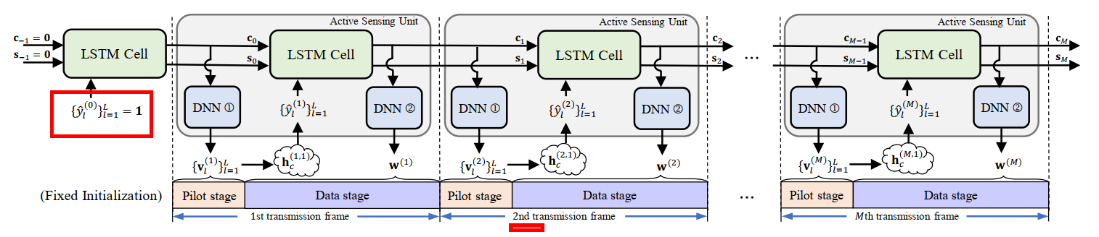
Tracking
The l-th pilot received by the AP
RIS sensing vector in the uplink phase (UE transmits the pilot)
(2)
RIS coefficient in downlink phase
(3)
The goal is to maximize the rate
H. Han, T. Jiang, et al. Active Beam Tracking with Reconfigurable Intelligent Surface, IEEE ICCASP, 2022

Slide 4
Active prediction sheme
The t-th received siganl at the AP is
The transmitter beamforming vector at time t+1 is
The receiver beamforming vector at time t+1 is
The AoA estimation problem is formulated as
The goal is to estimate the AoA at time T+1
The channel between the base station and target is assumed to be a Rician fading channel.

Slide 5
Fixed beamforming scheme
The t-th received siganl at the AP is
The transmitter beamforming vector at time 1 is
The receiver beamforming vector at time 1 is
The AoA estimation problem is formulated as
The goal is to estimate the AoA at time T+1
The channel between the base station and target is assumed to be a Rician fading channel.

Slide 6
Adaptive design scheme
The t-th received siganl at the AP is
The transmitter beamforming vector at time 1 is
The receiver beamforming vector at time 1 is
The AoA estimation problem is formulated as
For t > 1, the transmitter and receiver beamforming vectors are
The goal is to estimate the AoA at time T+1

Slide 7
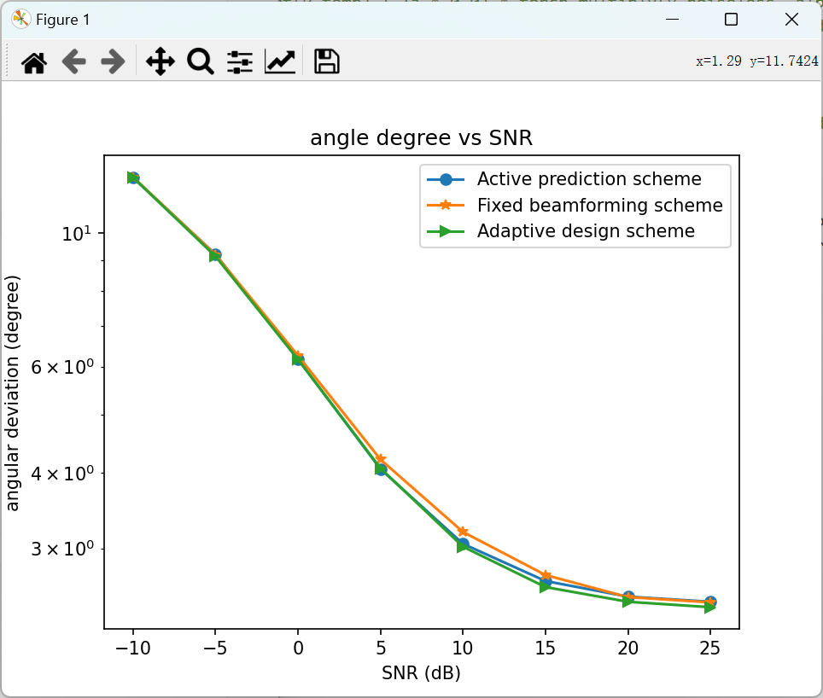
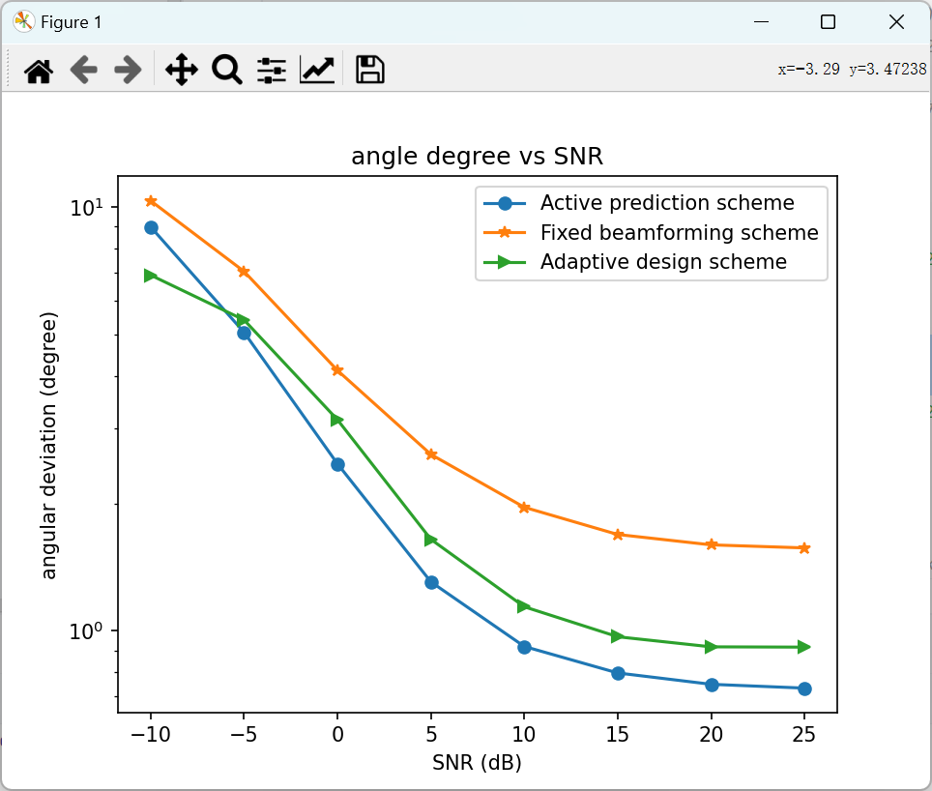
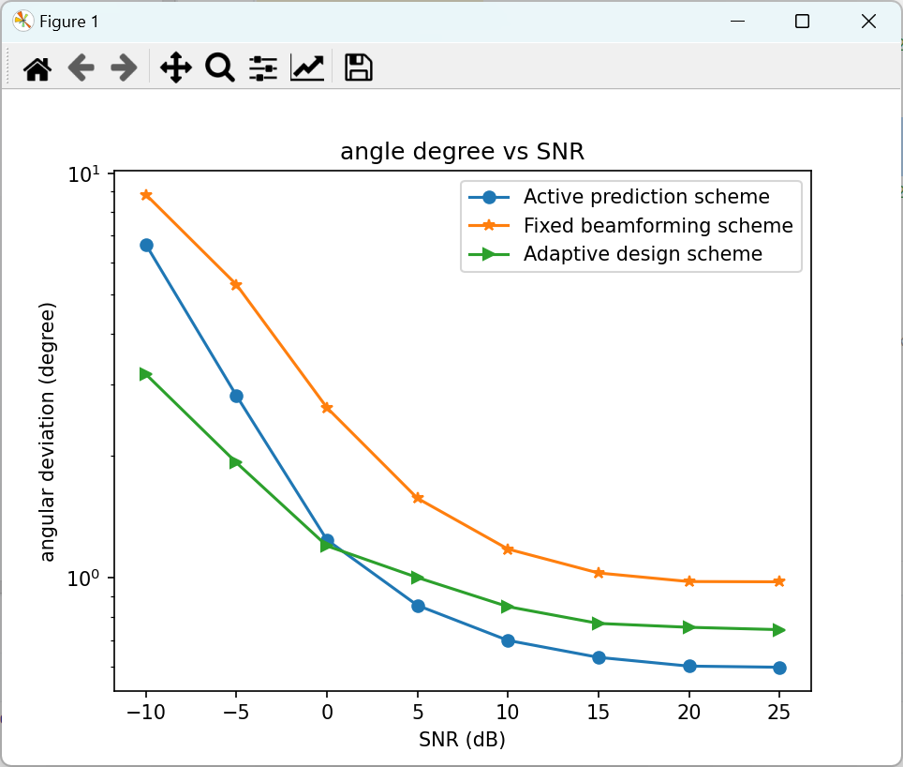
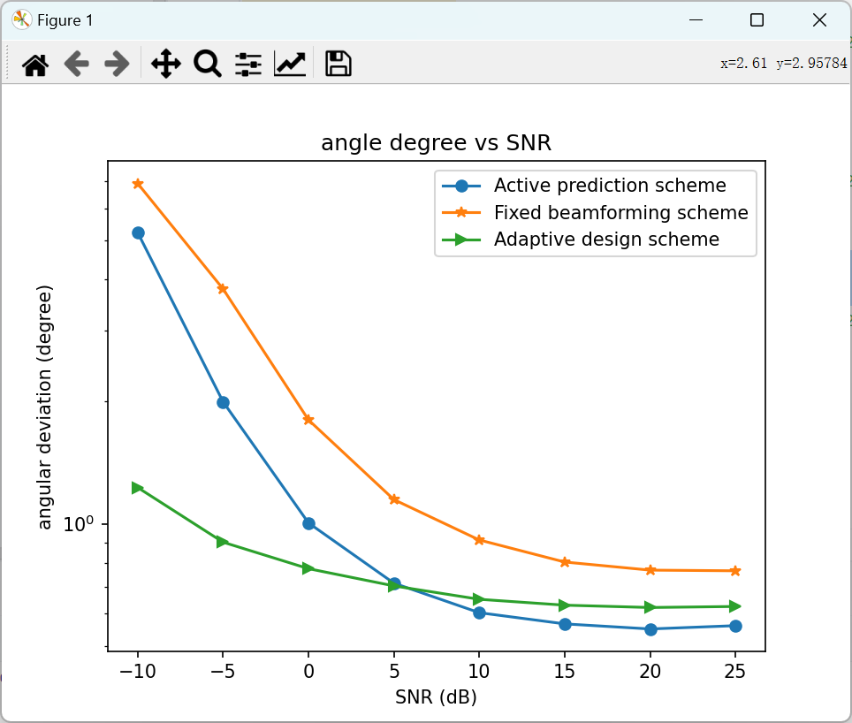
Simulations
Simulation settings:
Rician factor is K = 10
Initial AoA is uniformly distributed in [0°, 60°]
angular acceleration is 4.5 degree/s^2
The learning rate is 0.0001
learning epoch is 2000
In Fig. 3, when SNR < 0, the adaptive design outperforms the active prediction scheme.
Fig. 1 Simulated prediction performance when T = 2
Fig. 2 Simulated prediction performance when T = 3
Fig. 3 Simulated prediction performance when T = 4
Fig. 4 Simulated prediction performance when T = 5

Slide 8
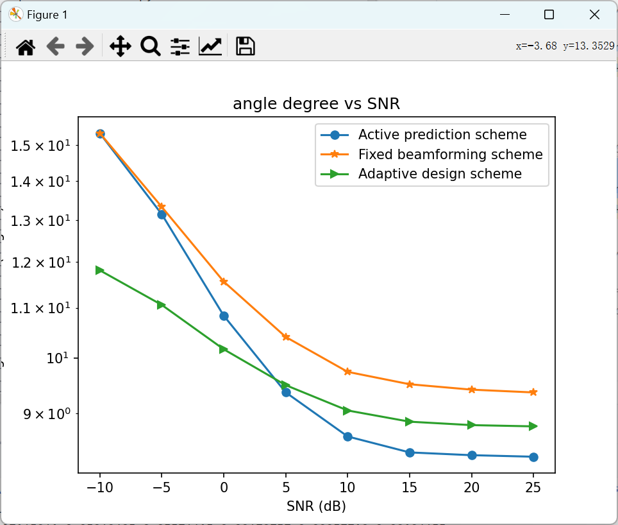
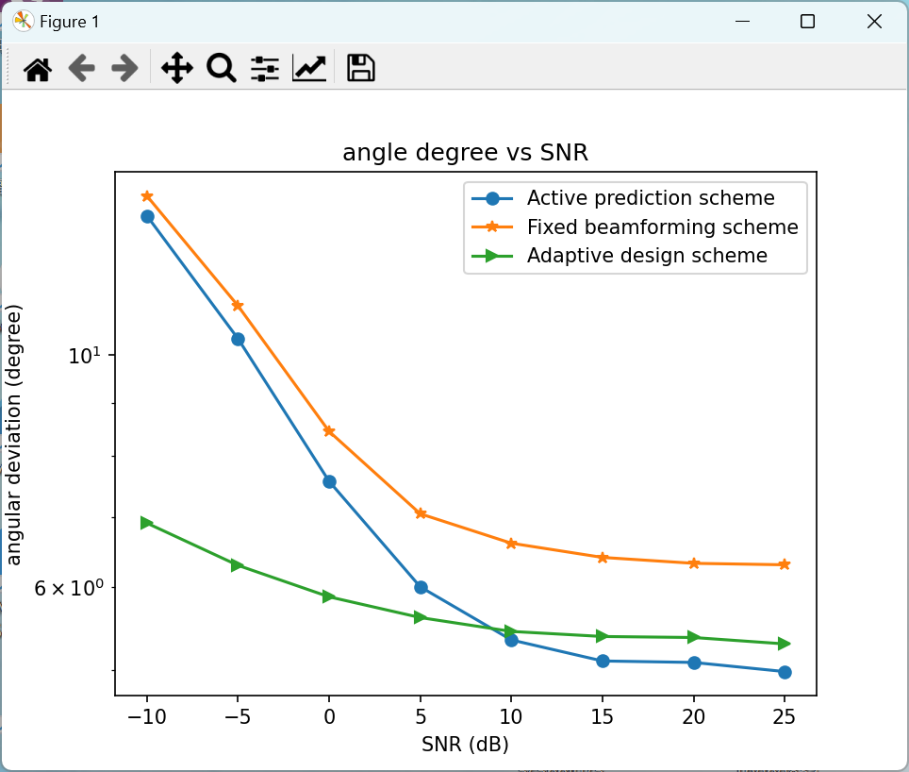
Fig. 3 Simulated prediction performance when T = 5, K=10
Fig. 1 Simulated prediction performance when T = 3, K = 10
Fig. 2 Simulated prediction performance when T = 3, K = 0.5
Fig. 4 Simulated prediction performance when T = 5, K=0.5

